Slide 1
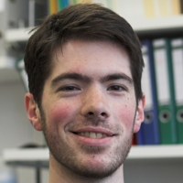
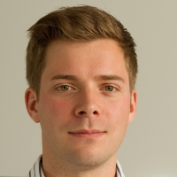
Nanostructures on ultra-clean two-dimensional electron gases
T. Ihn, C. Rössler, S. Baer, K. Ensslin
C. Reichl and W. Wegscheider

Slide 2
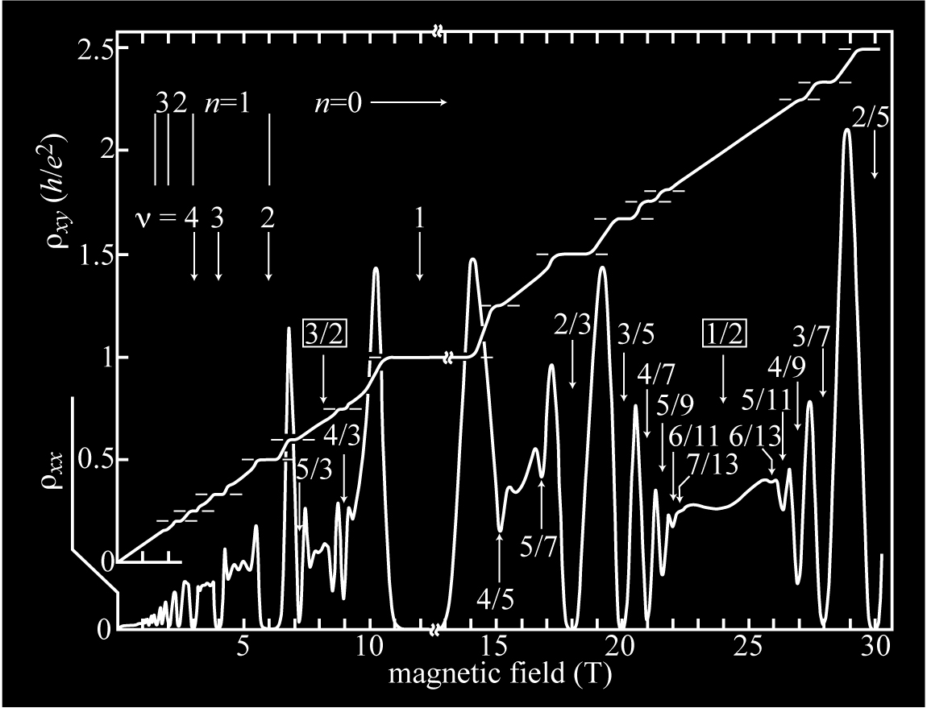
Electrons Clean Environment Magnetic Field
Rich variety of ground states
and excitations
Willett et al,
PRL 59, 1776 (1987)
odd denominator
fractions
Composite Fermions
J.K. Jain,
PRL 63, 199 (1989)

Slide 3
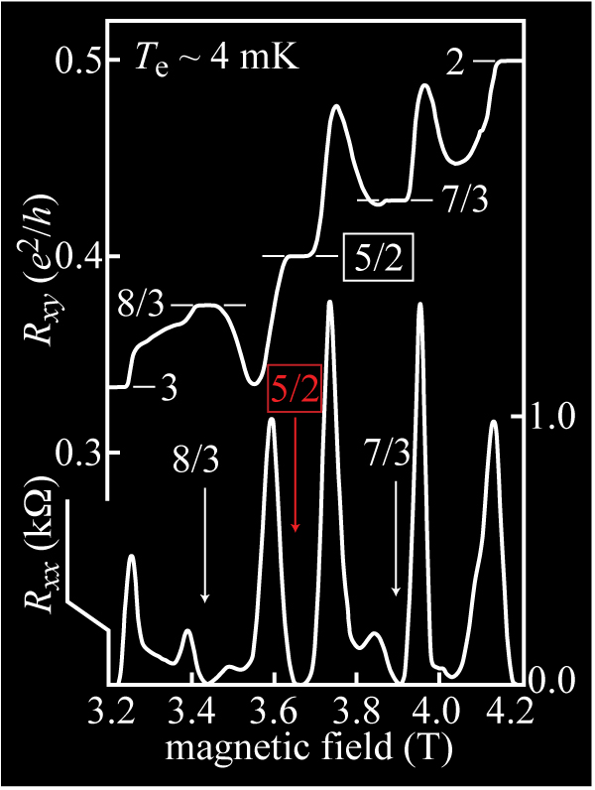
Electrons Clean Environment Magnetic Field
Rich variety of ground states
and excitations
Willett et al,
PRL 59, 1776 (1987)
W. Pan et al,
PRL 83, 3530 (1999)
even denominator
fractions
non-abelian
anyonic excitations
topological
quantum computing
S. Das Sarma
PRL 94, 166802 (2005)
T = 8 mK
μ = 17x10⁶ cm²/Vs

Slide 4
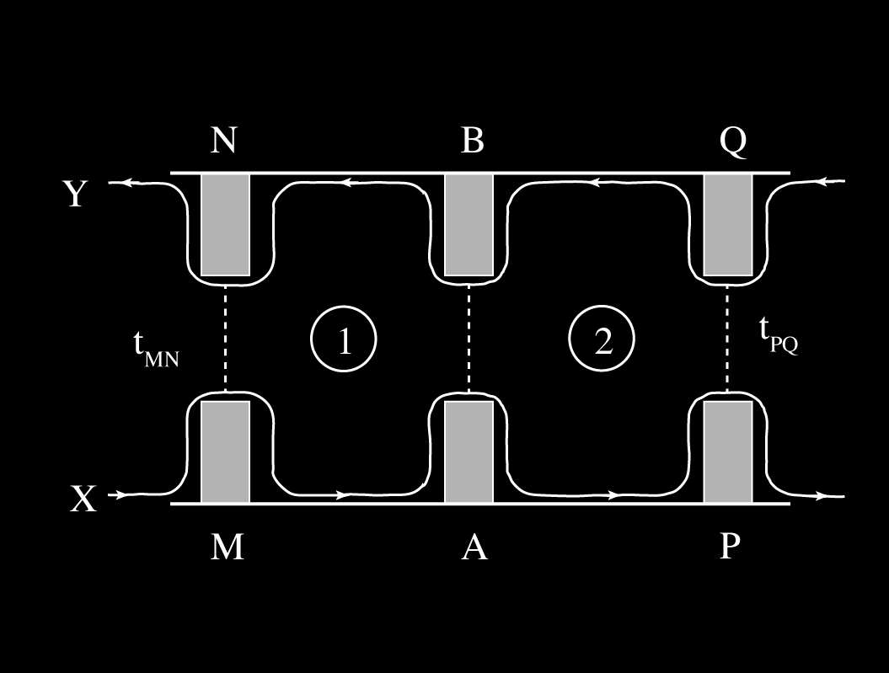
What we need
High-mobility 2DEGs Ultralow temperatures
Tunnel Barriers Quantum Point Contacts
Quantum Dots Interferometers
S. Das Sarma et al,
PRL 94, 166802 (2005)
utilize ν=5/2 state for
topological quantum computation

Slide 5
High Mobility 2DEGs
Au
15
0
T = 1.9 K
B = 0.1 T
Si
AlGaAs
ionized dopants
10
Si
+
+
+
+
+
+
-100
AlAs
screening layer
(in AlAs → Γ-band)
µ (10⁶ cm²/Vs)
depletion
z (nm)
5
GaAs
2DEG
-200
accumulation
screening layer
(in AlAs → Γ-band)
0
AlAs
0
1
2
3
4
5
Si
+
+
+
+
+
+
n_{S} (10¹¹ cm⁻²)
AlGaAs
ionized dopants
Si
n_{S}
C. Rössler et al., New J. Phys. 12, 043007 (2010)
4 doping layers, 2 screening layers
⇒ high mobility, but gating non-trivial
K.J. Friedland et al., PRL 77, 4616 (1996)
V. Umansky et al., J. Cryst. Growth 311, 1658 (2009)
Mobility µ > 10⁷ cm²/Vs
Density n_{S} = 3.5 x 10¹¹ cm⁻² ⇒ λ_{F} = 45 nm

Slide 6
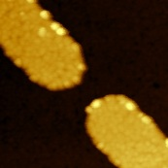
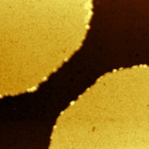
Quantum Point Contacts
QPC1: width w_{QPC} ≈ 150-200 nm ⇒ expect 2w_{QPC}/λ_{F}= 7-9 Subbands
Geometry: Quantum Point Contact
QPC2: width w_{QPC} ≈ 450-500 nm ⇒ expect 2w_{QPC}/λ_{F}= 20-22 Subbands
Geometry: Quantum Wire
15
QPC1
T = 1.3 K
V_{SD} = 0 mV
25
QPC2
T = 1.3 K
V_{SD} = 0 mV
20
10
15
G (2e²/h)
G (2e²/h)
10
5
G1
G1
5
0
200 nm
G2
0
500 nm
G2
-2.0
-1.6
-1.2
-4.5
-3.5
-2.5
-1.5
V_{G1&G2}(V)
V_{G1&G2} (V)
C. Rössler et al., New J. Phys. 13, 113006 (2011)

Slide 7
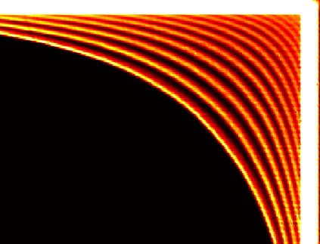
Scanning for Defects
-1
QPC1
T = 1.3 K
G1
-2
3
2
0.7 × 2e²/h
1
200 nm
G2
V_{G2} (V)
0
Count number of plateaus ⇒ QPC shifted across 200 nm
No apparent defects (i.e. resonances) within scan range
0.7 anomaly visible throughout scan range
-3
|dG/dV_{G1&G2}| (a.u.)
-4
0
1
-4
-3
-2
-1
V_{G1} (V)
S. Schnez, C. Rössler et al., Phys. Rev. B 84, 195322 (2011)

Slide 8
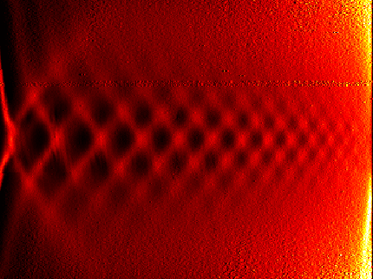
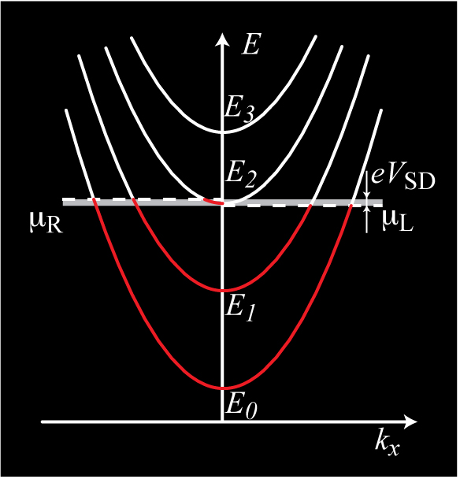
Finite Bias Transport Spectrum
G1
12
QPC1
T = 1.3 K
|dG/dV_{G1&G2}| (a.u.)
0
1
200 nm
G2
6
V_{SD} (mV)
0
1
2
3
2.5
3.5
1.5
3
4
-6
2
-12
-2.3
-2.1
-1.9
-1.7
-1.5
-1.3
V_{G1&G2} (V)
Higher-order resonances visible
Probe subband spacings ⇒ Extract shape parameters of confinement potential

Slide 9
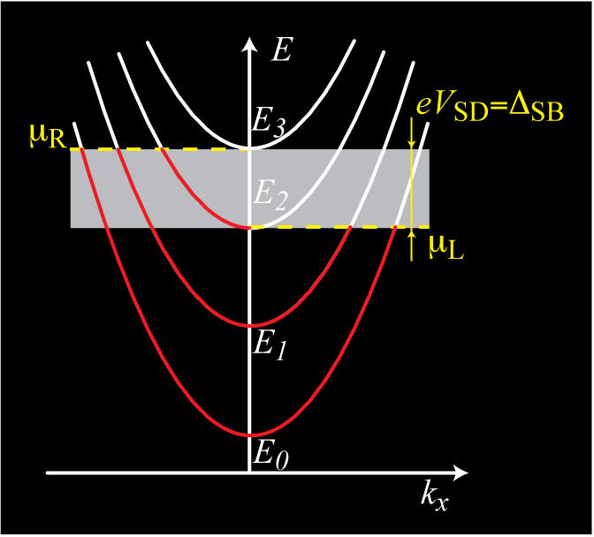
Finite Bias Transport Spectrum
G1
12
QPC1
T = 1.3 K
|dG/dV_{G1&G2}| (a.u.)
0
1
200 nm
G2
6
V_{SD} (mV)
0
1
2
3
2.5
3.5
1.5
3
4
-6
2
-12
-2.3
-2.1
-1.9
-1.7
-1.5
-1.3
V_{G1&G2} (V)
Higher-order resonances visible
Probe subband spacings ⇒ Extract shape parameters of confinement potential

Slide 10
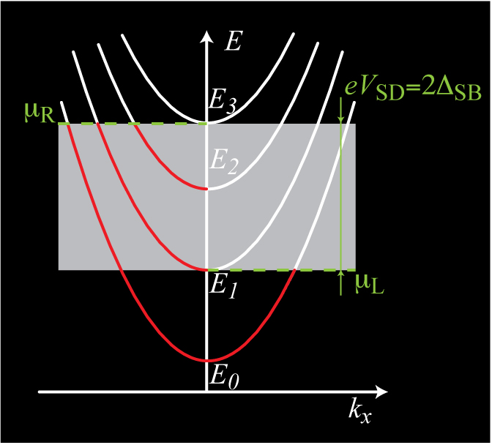
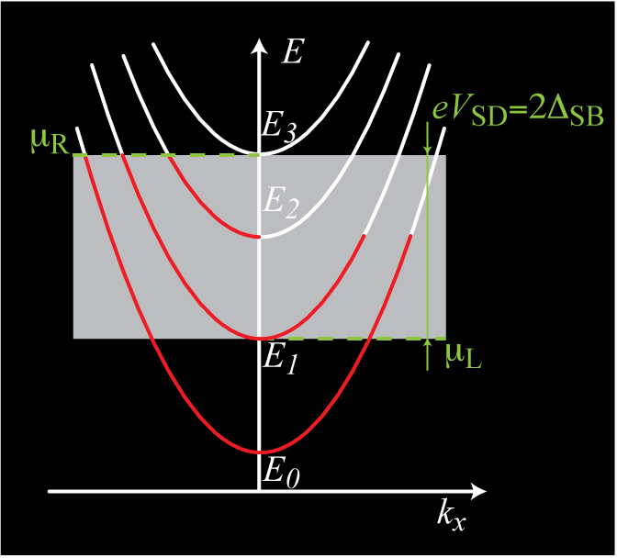
Finite Bias Transport Spectrum
G1
12
QPC1
T = 1.3 K
|dG/dV_{G1&G2}| (a.u.)
0
1
200 nm
G2
6
V_{SD} (mV)
0
1
2
3
2.5
3.5
1.5
3
4
-6
2
-12
-2.3
-2.1
-1.9
-1.7
-1.5
-1.3
V_{G1&G2} (V)
Higher-order resonances visible
Probe subband spacings ⇒ Extract shape parameters of confinement potential

Slide 11
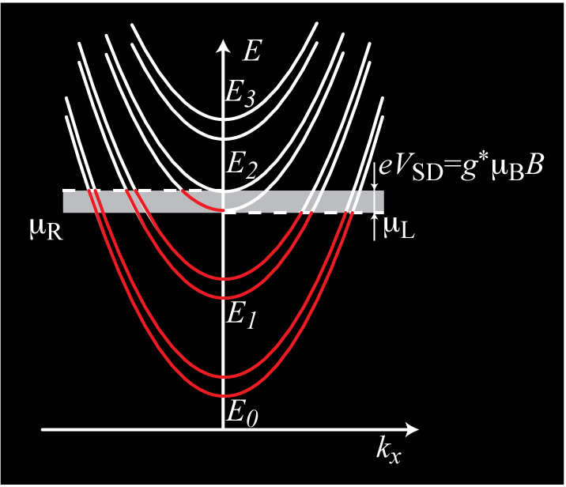
Lifting the Spin Degeneracy
4
ν_{QPC}
2
QPC3
B┴ = 2 T
V_{SD}= 0 mV
T = 0.1 K
0
-2.5
-2.0
-1.5
V_{G1&G2} (V)
ν_{BULK}
ν_{QPC}
ν_{BULK}

Slide 12
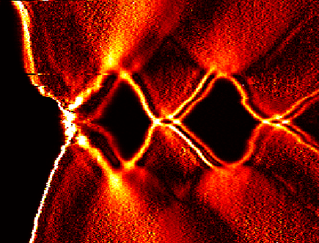
Lifting the Spin Degeneracy
12
QPC3
T = 0.1 K
B┴ = 2 T
|dG/dV_{G1&G2}| (a.u.)
0
1
6
4
3
5
V_{SD} (mV)
ν_{QPC}
0
2
4
6
2
pinched
off
QPC3
B┴ = 2 T
V_{SD}= 0 mV
T = 0.1 K
-6
0
-2.5
-2.0
-1.5
-12
V_{G1&G2} (V)
-2.7
-2.5
-2.2
-1.9
-1.6
-1.3
ν_{BULK}
V_{G1&G2} (V)
ν_{QPC}
Spin-gap enhanced by interactions: g_{eff} = -0.44 in GaAs |g*|~ 3.8 at ν_{QPC}= 5 |g*|~ 4.4 at ν_{QPC}= 3
ν_{QPC}= 1 obscured by 0.7 anomaly
ν_{BULK}

Slide 13
Fractional edge channels
B┴= 3.3 T
ν_{Bulk}= 4
QPC4
T = 0.1 K
V_{SD} = 0 mV
3
3
2
ν_{QPC}
2
1
1
0
B┴= 6.8 T
ν_{Bulk}= 2
5/3
4/3
Weak B-field: spin splitting
Intermediate B-field: integer and fractional edge-channels
Strong B-field & low density: Interference and localisation
⇒ Filter for (fractional) edge channels
1
1
ν_{QPC}
0
B┴= 12.8 T
ν_{Bulk}= 1
1
1
ν_{QPC}
2/3
0
-2.7
-2.5
-2.3
-2.1
-1.9
-1.7
-1.5
V_{G1&G2} (V)

Slide 14
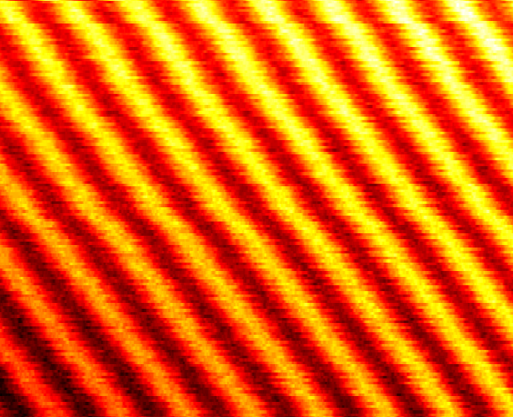
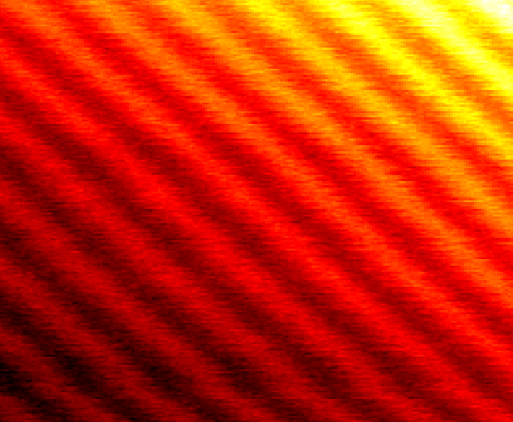
Localized Edge Channels ⇒ Coulomb Blockade
ν_{QPC} = 1
ν_{QPC} = 1
ν_{QPC} = 2
ν_{QPC} = 2
ν_{bulk} = 2
ν_{bulk} = 2
ν_{bulk} = 4
ν_{bulk} = 4
400 nm
400 nm
-2.205
1.67 nA
-1.107
3.05 nA
ΔB = 1.9 mT
ΔB = 1.0 mT
3.01 nA
1.65 nA
B (T)
B (T)
ΔV_{PG} = 7.7 mV
ΔV_{PG} = 7.2 mV
-2.196
-1.101
-0.66
V_{PG} (V)
-0.60
-0.65
V_{PG} (V)
-0.60
ΔV_{G}: adjust charge of localized edge channel
ΔB: redistribute electrons between edge channels see also: Y. Zhang et al., Phys. Rev. B 79, 241304 (2009)
N. Ofek et al., PNAS 107, 5276 (2010)
B. I. Halperin et al., Phys. Rev. B 83, 155440 (2011)

Slide 15
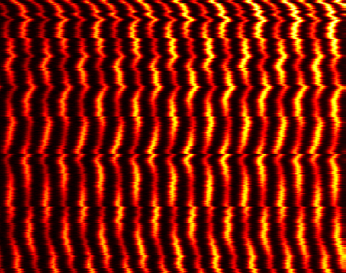
Coulomb-Coupled Edge Channels
50
I_{SD} (pA)
400 nm
ν_{QPC} ≈ 0, ν_{bulk} = 2
0
-0.66
V_{PG} (V)
-0.54
-2.1
50 pA
50
0 pA
ΔB = 3.0 mT
B (T)
I_{SD} (pA)
-2.112
ΔV_{PG} = 6.0 mV
-0.66
-0.60
0
V_{PG} (V)
-2.111
-2.102
B (T)
ΔV_{G} or ΔB: redistribute electrons between edge channels
High current if outer edge channel in resonance
Analogy to capacitively coupled double quantum dot

Slide 16
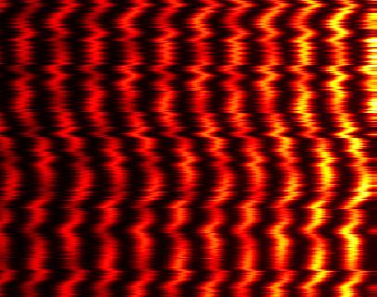
Coulomb-Coupled Edge Channels
400 nm
400 nm
ν_{QPC} ≈ 0, ν_{bulk} = 2
ν_{QPC} ≈ 0, ν_{bulk} = 4
-2.1
50 pA
-1.05
100 pA
0 pA
ΔB = 3.0 mT
0 pA
ΔB = 1.5 mT
B (T)
B (T)
-2.112
ΔV_{PG} = 6.0 mV
-1.058
ΔV_{PG} = 6.1 mV
-0.66
-0.60
-0.56
-0.50
V_{PG} (V)
V_{PG} (V)
see also:
P. L. McEuen et al., Phys. Rev. Lett. 66, 14 (1991)
N. C. van der Vaart et al., Phys. Rev. Lett. 73, 320 (1994)
T. Heinzel et al. , Phys. Rev. B 50, 20 (1994)
ΔV_{G} or ΔB: redistribute electrons between edge channels
High current if outer edge channel in resonance
Analogy to capacitively coupled double quantum dot

Slide 17
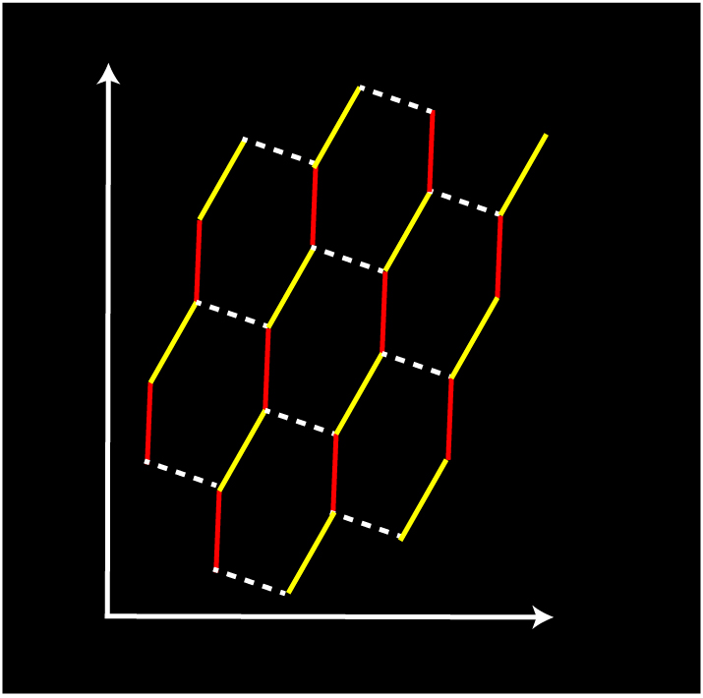
Analogy: Double Quantum Dot
C₁₋₂
C_{L}
ν = 1
ν = 2
ν = 0
E
y
C_{1-PG}
C_{2-PG}
400 nm
x
PG
ν_{QPC} ≈ 0, ν_{bulk} = 2
B
ν_{QPC} ≈ 0, ν_{bulk} = 4
n+1
m-2
n
m-2
n+1
m-1
n
m-1
ΔB = 1.5 mT
ΔB = 3.0 mT
n-1
m-1
n
m
n-1
m
ΔV_{PG} (shifted)
ΔV_{PG} (shifted)
V_{G}
Capacitor network model
Reconstuct hexagon pattern from peak positions
B-field axis tilted ⇒ edge state radii differ by ≈ 60 nm

Slide 18
Charge Detection
800
QPC
I_{QPC}(pA)
760
0
t (s)
10
600
400 nm
# of Events
Capacitively coupled QPC
Detect transferred charge
Future studies: Can we detect fractional charge?
0
-820
-760
V_{G} (V)
S. Baer, C. Rössler et al., submitted

Slide 19
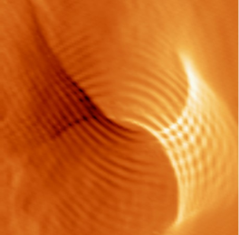
Summary & Outlook
Quantum Point Contacts in Ultra Clean Electron Systems
Extract shape parameters
Many-body effects
0.7 anomaly
Enhanced spin-splitting
Fractional edge channels
C. Rössler et al., New J. Phys. 12, 043007 (2010)
C. Rössler et al., New J. Phys. 13, 113006 (2011)
Interferometry
Interplay between Coulomb-blockade and Aharonov-Bohm effect
Charge detection in the QHE-regime
S. Baer, C. Rössler et al., submitted (2012)
Scanning Gate Microscopy
Imaging interference in real space
Talk of Aleksey Kozikov on Friday
S. Schnez, CR et al., Phys. Rev. B 84, 195322 (2011)
A. A. Kozikov , C. Rössler et al., submitted (2012)
500 nm

